Slide 1

P peline
The Data
Introductory Statistics
© Jennifer Mankoff
The Data Pipeline; HCII; Spring 2014

Slide 2
We’ve covered aspects of the whole pipeline
Question
Is it the right question?
Collect Data
Is it the right data for the question?
How hard/easy is it to collect?
Clean Data
What flaws exist in the data?
How do we address them?
Is it answerable?
Explore Data
Stats/Graphs/ML
Use data
Communicate/Predict/…
Intuition

Slide 3
But now we’re stopping here
Exploring multiple perspectives on data exploration & use
Multiple stakeholders
Multiple techniques (viz now, stats next, ml after that)
Multiple options (story telling, exploration, …)
Question
Is it the right question?
Collect Data
Is it the right data for the question?
How hard/easy is it to collect?
Clean Data
What flaws exist in the data?
How do we address them?
Is it answerable?
Explore Data
Stats/Graphs/ML
Use data
Communicate/Predict/…
Intuition

Slide 4
We talked about data exploration (doing the last two steps for you)
Transformations such as normalization, logs, and feature creation
Plots and their value – stem & leaf; boxplot; histogram
Distributions and some of their underlying assumptions; relating this back to your understanding of the data

Slide 5
We talked about visualization design (for others)
Key questions a viz author or viewer should ask about a viz
What is its goal?
Does it use good design?
Have there been usability studies done? What do they show?
Are data provenance & analysis approach documented
Notes:
(and do they match the goal?)

Slide 6
We discussed holistic design goals
Data & View Specifications | Visualize (choose encoding) Filter (focus on relevant items) Sort (expose patterns) Derive values or models
View Manipulation | Select (to highlight, filter, or manipulate) Navigate (zoom to examine patterns & detail) Coordinate (linked exploration) Organize windows and workspaces.
Process & Provenance | Record analysis histories Annotate patterns to document findings. Share views and annotations Guide users through analysis tasks or stories.
Heer & Shneiderman: Interactive Dynamics for Visual Analysis; ACM QUEUE, Feb 20, 2012
Notes:
Tailor to the application and the domain
Create highly interactive and integrated systems
Embed the visualization within a larger application
Provide alternative views

Slide 7
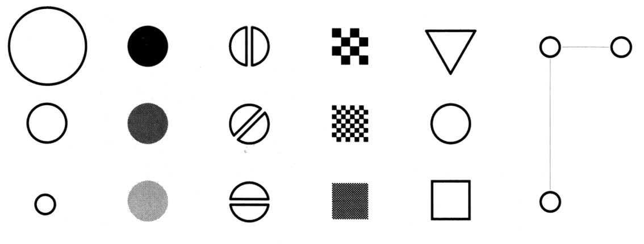
And specific techniques
Size
Value
Orientation
Texture
Shape
Position (2D / 3D)
Bertin’s ‘retinal variables’ form the basis for all forms of visual coding. A visual code can be based on (from left to right) contrasts of different types. Hue (chromatic color) provides an addition dimension not shown here.
Kevin Mullet and Darrell Sano, Designing Visual Interfaces
Slide from Marti Hearst/Jeff Heer via Jason Hong
Notes:
Note that while size and other cues provide for quantitative comparison, color (even luminance) only provides for ordering.
If the goal is contrast along any of these axes, make it distinct!

Slide 8
And we looked at many case studies (small and large)
Raised questions of context (social vs not; community structure)
Difficulty of separating viz & goals from application & goals
Difficulty of getting clear field vs lab results

Slide 9
Goals
After this, you should be able to:
Be able to discuss the difference between frequency and process data
Understand how to go about selecting a technique for testing your hypothesis
Understand the key assumptions behind different statistical tests
Adapted from http://www.fordham.edu/economics/Vinod/correl-regr.ppt

Slide 10
Process vs Frequency data
Formulate
hypotheses
(Collect) & Analyze data to test hypotheses
(Bayesian inference) (Statistical inference)

Slide 11
Process vs Frequency Data
Potential for Logical Error
Potential for Systematic Error
Formulate
hypotheses
(Collect) & Analyze data to test hypotheses

Slide 12
Process vs Frequency Data
Formulate
hypotheses
(Collect) & Analyze data to test hypotheses
Potential for
Random Error
Potential for Errors of Interpretation
Accept hypothesis
Reject hypothesis
Notes:
Random error (chance) can be controlled by statistical significance
or by confidence interval

Slide 13
Inference
Blends background knowledge & data
Estimates actual ratio in the population at large of things being tested for
Bayesian in nature
Helps provide grounding for what is expected in your data, lets you judge if there is sample bias, etc.

Slide 14
Common Statistical Tests
Outcome Variable | Are the observations independent or correlated? |  | Alternatives if the normality assumption is violated (and small sample size):
 | independent | correlated
Continuous (e.g. pain scale, cognitive function) | T-test: compares means between two independent groups ANOVA: compares means between more than two independent groups Pearson’s correlation coefficient (linear correlation): shows linear correlation between two continuous variables Linear regression: multivariate regression technique used when the outcome is continuous; gives slopes | Paired t-test: compares means between two related groups (e.g., the same subjects before and after) Repeated-measures ANOVA: compares changes over time in the means of two or more groups (repeated measurements) Mixed models/GEE modeling: multivariate regression techniques to compare changes over time between two or more groups; gives rate of change over time | Non-parametric statistics Wilcoxon sign-rank test: non-parametric alternative to the paired ttest Wilcoxon sum-rank test (=Mann-Whitney U test): non-parametric alternative to the ttest Kruskal-Wallis test: non-parametric alternative to ANOVA Spearman rank correlation coefficient: non-parametric alternative to Pearson’s correlation coefficient
Adapted from: www.stanford.edu/~kcobb/hrp259/lecture13.ppt

Slide 15
Common Statistical Tests: T-test
Outcome Variable | Are the observations independent or correlated? |  | Alternatives if the normality assumption is violated (and small sample size):
 | independent | correlated
Continuous (e.g. pain scale, cognitive function) | T-test: compares means between two independent groups ANOVA: compares means between more than two independent groups Pearson’s correlation coefficient (linear correlation): shows linear correlation between two continuous variables Linear regression: multivariate regression technique used when the outcome is continuous; gives slopes | Paired t-test: compares means between two related groups (e.g., the same subjects before and after) Repeated-measures ANOVA: compares changes over time in the means of two or more groups (repeated measurements) Mixed models/GEE modeling: multivariate regression techniques to compare changes over time between two or more groups; gives rate of change over time | Non-parametric statistics Wilcoxon sign-rank test: non-parametric alternative to the paired ttest Wilcoxon sum-rank test (=Mann-Whitney U test): non-parametric alternative to the ttest Kruskal-Wallis test: non-parametric alternative to ANOVA Spearman rank correlation coefficient: non-parametric alternative to Pearson’s correlation coefficient
Adapted from: www.stanford.edu/~kcobb/hrp259/lecture13.ppt

Slide 16
Common Statistical Tests: Variations on t-test
Outcome Variable | Are the observations independent or correlated? |  | Alternatives if the normality assumption is violated (and small sample size):
 | independent | correlated
Continuous (e.g. pain scale, cognitive function) | T-test: compares means between two independent groups ANOVA: compares means between more than two independent groups Pearson’s correlation coefficient (linear correlation): shows linear correlation between two continuous variables Linear regression: multivariate regression technique used when the outcome is continuous; gives slopes | Paired t-test: compares means between two related groups (e.g., the same subjects before and after) Repeated-measures ANOVA: compares changes over time in the means of two or more groups (repeated measurements) Mixed models/GEE modeling: multivariate regression techniques to compare changes over time between two or more groups; gives rate of change over time | Non-parametric statistics Wilcoxon sign-rank test: non-parametric alternative to the paired ttest Wilcoxon sum-rank test (=Mann-Whitney U test): non-parametric alternative to the ttest Kruskal-Wallis test: non-parametric alternative to ANOVA Spearman rank correlation coefficient: non-parametric alternative to Pearson’s correlation coefficient
Adapted from: www.stanford.edu/~kcobb/hrp259/lecture13.ppt

Slide 17
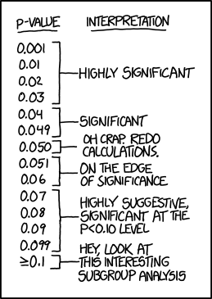
Common Statistical Tests: T-Test
T-Test
Notes:
Not as simple as it might seem…

Slide 18
Reminder: Statistics Terms
Term | Meaning | Common Uses
Std dev | The range around the mean in which many values fall | Describing the degree of variability in the sample
Std error | Estimates variability in the mean if the experiment were repeated | Gives an estimate of the population mean
Independent data | Values from separate experiments (not linked) | Testing hypotheses about a population
Normal | Data fits a normal curve (definition of ‘data’ varies based on context) | Required for many statistical tests
Notes:
XX NOTE: THIS slide seemed out of place in lecture and may not have the correct terms on it either. Rethink where to put it.

Slide 19
Common Statistical Tests: T-Test
T-Test
Tests for difference between two samples
Best used to determine what is ‘worthy of a second look’
Limited in its applicability to normal, independent data
The more implausible the hypothesis, the greater chance that it is a ‘false alarm’
Does not help to document effect size [the actual difference between groups], just effect likelihood
Susceptible to ‘data dredging’
Varied tests looking for a significant result
Adjustments mid experiment
Notes:
changes in a few data-analysis decisions can increase the false-positive rate in a single study to 60%.

Slide 20
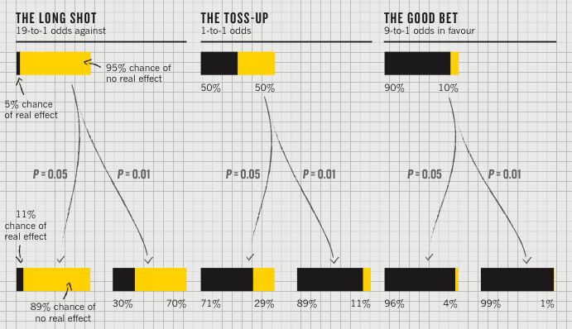
P value [Nuzzo]
P value
Best used to determine what is ‘worthy of a second look’ [Nuzzo]
Limited in its applicability

Slide 21
Plausibility of the hypothesis (inference)
P value
Best used to determine what is ‘worthy of a second look’ [Nuzzo]
Limited in its applicability
Before the
experiment

Slide 22
‘Statistical significance’
P value
Best used to determine what is ‘worthy of a second look’ [Nuzzo]
Limited in its applicability
Calculated p value
Notes:
Does not incorporate the inference (the top of this chart) directly

Slide 23
Actual implications of the p-value
P value
Best used to determine what is ‘worthy of a second look’ [Nuzzo]
Limited in its applicability
A small p makes the hypothesis more plausible
Notes:
Does not incorporate the inference (the top of this chart) directly

Slide 24
Potential Errors
 | Actually is: Same as Population | Actually is: Different than Population
Decision: is Same | H₀ (null): No difference | Type II error
Decision: is Different | Type I error | H₁: Real difference

Slide 25
Could our Estimate Be Wrong?
 | Actually is: Same as Population | Actually is: Different than Population
Decision: is Same | H₀ (null): No difference | Type II error
Decision: is Different | Type I error | H₁: Real difference
Erroneously detect a difference (false positive). Directly affected by p: at .05 we make a Type I error 5 out of 100 tries. .01 reduces this error to 1 out of 100 tries.

Slide 26
Could our Estimate Be Wrong?
 | Actually is: Same as Population | Actually is: Different than Population
Decision: is Same | H₀ (null): No difference | Type II error
Decision: is Different | Type I error | H₁: Real difference
Fail to detect a true difference (false negative) Indirectly affected by p: Depends on the size of the mean difference and the sample size.

Slide 27
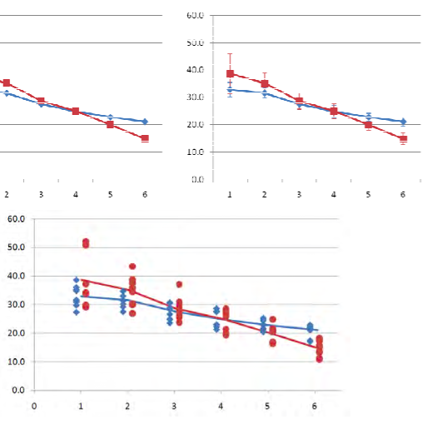
Reporting Should Help Document
Example Graphs [Dunlop]
Example Text
Minimum:
P value
Effect size
Verification of normality/independence
Sampling strategy
Good extras
Confidence Intervals
Power
Study plan (what was added/original)
Means only (bad) Means + error bars (minimal)
Means + Scatterplot (domain appropriate and informative)

Slide 28
Common Statistical Tests: Correlation
Outcome Variable | Are the observations independent or correlated? |  | Alternatives if the normality assumption is violated (and small sample size):
 | independent | correlated
Continuous (e.g. pain scale, cognitive function) | T-test: compares means between two independent groups ANOVA: compares means between more than two independent groups Pearson’s correlation coefficient (linear correlation): shows linear correlation between two continuous variables Linear regression: multivariate regression technique used when the outcome is continuous; gives slopes | Paired t-test: compares means between two related groups (e.g., the same subjects before and after) Repeated-measures ANOVA: compares changes over time in the means of two or more groups (repeated measurements) Mixed models/GEE modeling: multivariate regression techniques to compare changes over time between two or more groups; gives rate of change over time | Non-parametric statistics Wilcoxon sign-rank test: non-parametric alternative to the paired ttest Wilcoxon sum-rank test (=Mann-Whitney U test): non-parametric alternative to the ttest Kruskal-Wallis test: non-parametric alternative to ANOVA Spearman rank correlation coefficient: non-parametric alternative to Pearson’s correlation coefficient
Adapted from: www.stanford.edu/~kcobb/hrp259/lecture13.ppt

Slide 29
Common Statistical Tests
P value
Correlation
Measures association (linear relationship) between two variables
These variables change together
Usually scale (interval or ratio) variables
Limited in its applicability to normal, linearly related data with consistent scatter and no outliers
Notes:
changes in a few data-analysis decisions can increase the false-positive rate in a single study to 60%.
----- Meeting Notes (2/19/15 10:00) -----
is it the errors or the data if you hold x constant that has to be normal in y

Slide 30
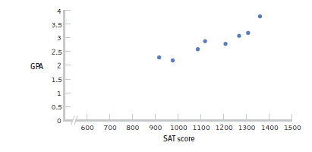
Positive Correlation
High scores on one variable tend to have high scores on the other variable
Adapted from: http://www.sjsu.edu/people/steven.macramalla/courses/stats95/s1/lecture 10

Slide 31
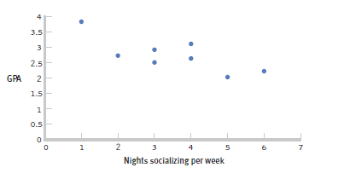
Negative Correlation
High scores on one variable tend to have low scores on the other variable ‘inverse relation’
Adapted from: http://www.sjsu.edu/people/steven.macramalla/courses/stats95/s1/lecture 10

Slide 32
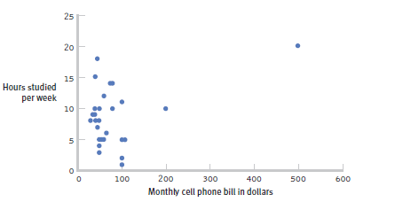
The effect of outliers
One outlier changed the correlation from -0.14 to 0.39!
Adapted from: http://www.sjsu.edu/people/steven.macramalla/courses/stats95/s1/lecture 10
Notes:
Note negative to positive change among other things
----- Meeting Notes (2/19/15 10:00) -----
cook's distance

Slide 33
Common Statistical Tests
P value
Correlation
Measures association (linear relationship) between two variables
These variables change together
Usually scale (interval or ratio) variables
Limited in its applicability to normal, linearly related data with consistent scatter and no outliers
Often mistaken for causation
Notes:
changes in a few data-analysis decisions can increase the false-positive rate in a single study to 60%.

Slide 34
Correlation is not Causation
There is a 0.91 correlation between ice cream consumption and drowning deaths.
Does eating ice cream cause drowning?
Does grief cause us to eat more ice cream?
Adapted from: http://www.sjsu.edu/people/steven.macramalla/courses/stats95/s1/lecture 10

Slide 35
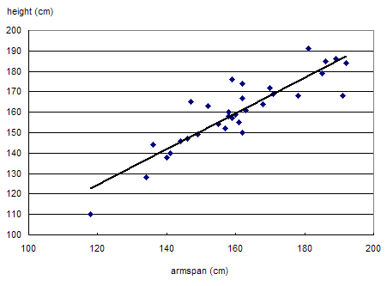
Correlation is not Causation
Armspan and height are strongly correlated.
Adapted from: http://www.sjsu.edu/people/steven.macramalla/courses/stats95/s1/lecture 10

Slide 36
Common Statistical Tests
P value
Correlation
Measures association (linear relationship) between two variables
These variables change together
Usually scale (interval or ratio) variables
Limited in its applicability to normal, linearly related data with consistent scatter and no outliers
Often mistaken for causation
Range restriction & other manipulations can affect or even reverse outcomes (Simpson’s paradox)
Notes:
changes in a few data-analysis decisions can increase the false-positive rate in a single study to 60%.

Slide 37
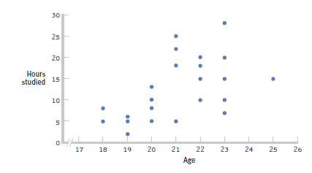
Restricted Range: Sampling Bias
Boys and girls who performed in the top 2% to 3% on standardized
Adapted from: http://www.sjsu.edu/people/steven.macramalla/courses/stats95/s1/lecture 10
Notes:
tests - a much smaller range than the full population from which the researchers could have drawn their sample.

Slide 38
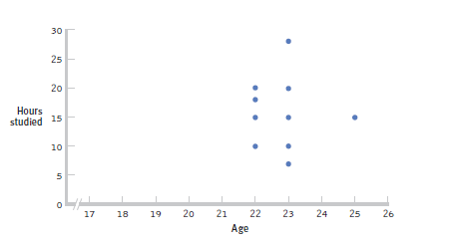
Further Restrictions
Only students between the ages of 22 and 25: r= 0.05.
Adapted from: http://www.sjsu.edu/people/steven.macramalla/courses/stats95/s1/lecture 10

Slide 39
Simpson’s Paradox
http://en.wikipedia.org/wiki/Simpson's_paradox
Introducing another variable may change our understanding of the data
It may even reverse the initial conclusions

Slide 40
A situation where the subgroups are always the way to go
 | Treatment A | Treatment B
Small Stones | Group 1 93% (81/87) | Group 2 87% (234/270)
Large Stones | Group 3 73% (192/263) | Group 4 69% (55/80)
Both | 78% (273/350) | 83% (289/350)
Notes:
The practical significance of Simpson's paradox surfaces in decision making situations where it poses the following dilemma: Which data should we consult in choosing an action, the aggregated or the partitioned? In the Kidney Stone example above, it is clear that if one is diagnosed with "Small Stones" or "Large Stones" the data for the respective subpopulation should be consulted and Treatment A would be preferred to Treatment B. But what if a patient is not diagnosed, and the size of the stone is not known; would it be appropriate to consult the aggregated data and administer Treatment B? This would stand contrary to common sense; a treatment that is preferred both under one condition and under its negation should also be preferred when the condition is unknown.

Slide 41
Gender Discrimination?
 | Applicants | Admitted
Men | 8442 | 44%
Women | 4321 | 35%
Notes:
On the other hand, if the partitioned data is to be preferred a priori, what prevents one from partitioning the data into arbitrary sub-categories (say based on eye color or post-treatment pain) artificially constructed to yield wrong choices of treatments? Pearl[2] shows that, indeed, in many cases it is the aggregated, not the partitioned data that gives the correct choice of action. Worse yet, given the same table, one should sometimes follow the partitioned and sometimes the aggregated data, depending on the story behind the data; with each story dictating its own choice. Pearl[2] considers this to be the real paradox behind Simpson's reversal.

Slide 42
Gender Discrimination?
Dept | Men | Women
A | 825/62% | 108/82%
B | 560/63% | 25/68%
C | 325/37% | 593/34%
D | 417/33% | 375/35%
E | 191/28% | 393/24%
F | 373/6% | 341/7%
Bickel et al.[13]: women tended to apply to competitive departments with low rates of admission (English), men tended to apply to less-competitive departments with high rates of admission engineering and chemistry)
Notes:
On the other hand, if the partitioned data is to be preferred a priori, what prevents one from partitioning the data into arbitrary sub-categories (say based on eye color or post-treatment pain) artificially constructed to yield wrong choices of treatments? Pearl[2] shows that, indeed, in many cases it is the aggregated, not the partitioned data that gives the correct choice of action. Worse yet, given the same table, one should sometimes follow the partitioned and sometimes the aggregated data, depending on the story behind the data; with each story dictating its own choice. Pearl[2] considers this to be the real paradox behind Simpson's reversal.

Slide 43
Common Statistical Tests
P value
Correlation
Measures association (linear relationship) between two variables
These variables change together
Usually scale (interval or ratio) variables
Limited in its applicability to normal, linearly related data with consistent scatter and no outliers
Often mistaken for causation
Range restriction & other manipulations can affect or even reverse outcomes (Simpson’s paradox)
Cannot easily determine if there is a mediating variable
Notes:
changes in a few data-analysis decisions can increase the false-positive rate in a single study to 60%.

Slide 44
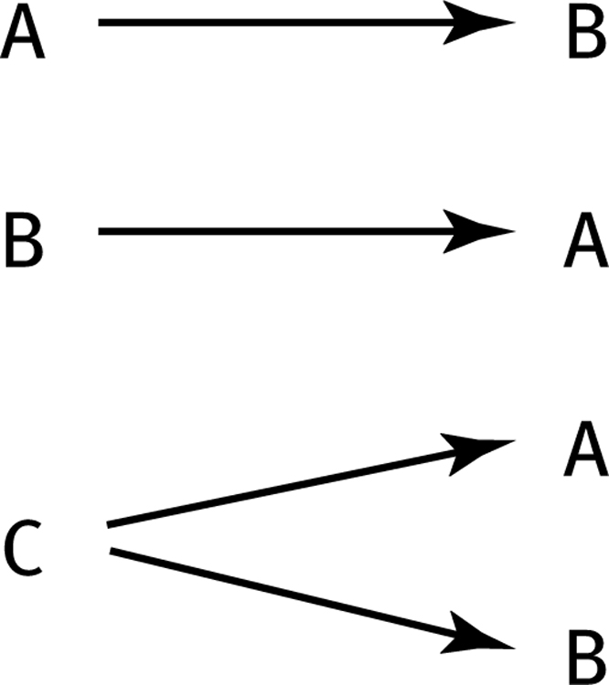
How can we test these associations?
Three Possible Causal Explanations for a Correlation
Adapted from: http://www.sjsu.edu/people/steven.macramalla/courses/stats95/s1/lecture 10

Slide 45
Randomized Trial (gold standard frequentist approach)
Assume A and B_{i} are correlated…
Measure current (A) state)
Activity
Measure (B_{i})

Slide 46
Randomized Trial
Assume A and B_{i} are correlated…
And that Activity links them
Measure current (A) state)
Activity
Measure (B_{i})

Slide 47
Randomized Trial
Recruit Participants
Activity becomes the intervention
Randomize
Measure current (A) state)
Measure current (A) state)
Measure current (A) state)
Intervention Group
Control Group
Activity
Measure (B_{i})
Measure (B_{c})
Measure (B_{i})

Slide 48
Randomized Trial
Recruit Participants
Activity becomes the intervention
Randomize
Measure current (A) state)
Measure current (A) state)
Measure current (A) state)
Intervention Group
Control Group
Activity
Measure (B_{i})
Measure (B_{c})
Measure (B_{i})
Test for significant difference between A & B_{i}; B_{i} and B_{c}; A & B_{c}

Slide 49
Common Statistical Tests: Regression
Outcome Variable | Are the observations independent or correlated? |  | Alternatives if the normality assumption is violated (and small sample size):
 | independent | correlated
Continuous (e.g. pain scale, cognitive function) | T-test: compares means between two independent groups ANOVA: compares means between more than two independent groups Pearson’s correlation coefficient (linear correlation): shows linear correlation between two continuous variables Linear regression: multivariate regression technique used when the outcome is continuous; gives slopes | Paired t-test: compares means between two related groups (e.g., the same subjects before and after) Repeated-measures ANOVA: compares changes over time in the means of two or more groups (repeated measurements) Mixed models/GEE modeling: multivariate regression techniques to compare changes over time between two or more groups; gives rate of change over time | Non-parametric statistics Wilcoxon sign-rank test: non-parametric alternative to the paired ttest Wilcoxon sum-rank test (=Mann-Whitney U test): non-parametric alternative to the ttest Kruskal-Wallis test: non-parametric alternative to ANOVA Spearman rank correlation coefficient: non-parametric alternative to Pearson’s correlation coefficient
Adapted from: www.stanford.edu/~kcobb/hrp259/lecture13.ppt

Slide 50
Common Statistical Tests
P value
Correlation
Two variables are treated as equals.
Regression
One variable is considered independent (=predictor) (X) and the other dependent (=outcome) (Y).
In machine learning, regression predicts the value of a continuous variable based on one or more features
Assumptions
error values are normally distributed with consistent scatter, and that variables are linearly related
Variables don’t measure the same thing
Number of features < amount of data
Notes:
changes in a few data-analysis decisions can increase the false-positive rate in a single study to 60%.

Slide 51
Precision & Recall [Colquhuon]
Precision = the number of people who will be correctly categorized as not having a condition
Recall = the number of people who will be correctly categorized as having a condition
Example: Test for mild cog. impairment (P=.95; R=.8)
1% rate in the population: False discovery rate = 85%

Slide 52
Summary
Start with process data and analysis, only then explore frequency data and analysis
Notes:
Note: Add a little more about the last point

Slide 53
Summary
Start with process data and analysis, only then explore frequency data and analysis
Most statistical tests
depend on the central limit theorem and thus its assumptions
The sample is normal
If multiple samples, they are independent & have the same variance
return estimates and can make two kinds of errors (Type I and Type II)
Can only reject hypotheses
Notes:
Note: Add a little more about the last point

Slide 54
Summary
Start with process data and analysis, only then explore frequency data and analysis
Most statistical tests depend on normal data
What if the data are not normal?
Use a non-parametric test (no assumptions about the distribution of the sample; but may have other assumptions)
Notes:
Note: Add a little more about the last point

Slide 55
Summary
Start with process data and analysis, only then explore frequency data and analysis
Most statistical tests depend on normal data
Interpreting results must be done with respect to real world expectations about the population
Notes:
Note: Add a little more about the last point

Slide 56
Summary
Start with process data and analysis, only then explore frequency data and analysis
Most statistical tests depend on normal data
Interpreting results must be done with respect to real world expectations about the population
Potential pitfalls include
Low rate of replication of findings [Ionnadis]
Bias (‘findings’ may actually be measuring bias) [Ionnadis]
Low power (probability of rejecting a false hypothesis) in studies [Colquhuon]
Lack of careful data exploration (charts & summarization) [Hart]
Notes:
Note: Add a little more about the last point

Slide 57
Review, continued…
Sampling choices bias results or even turn them on their head! (this latter issue is called Simpson’s Paradox). Sometimes we should subsample; sometimes we should not

